Slide 1
Bon Secours
Maryview Medical Center
Student Volunteer
Online Orientation

Slide 2

WELCOME to the Student Volunteer Program at Bon Secours Maryview Medical Center!!
You are now a part of a very important team of professionals that offer
“Good Help to Those in Need”
and your presence is added value
to our organization.
Thank you for your willingness to participate in this program.

Slide 3
Contact information:
Volunteer Director: Sherry Hill
E-mail: sherry_hill2@bshsi.org
Office: 757-398-2314

Slide 4


Please read the information contained in this orientation packet. You are responsible for understanding and being accountable for this material so please ask for clarification if you do not understand the content.
At the end of this packet, you will be directed to complete a knowledge quiz. Good Luck!!

Slide 5
Why are we here?
We are here to extend compassionate care by improving the health and well-being of our communities and bring good help to those in need.

Slide 6

Customer Service
Student Volunteers play a vital role at
Maryview and Harbour View
Be patient
Be kind
Be helpful
Be friendly
Always SMILE
Represent Bon Secours Maryview
positively always!

Slide 7

HIPAA / Privacy Practice

Slide 8

What is HIPAA?
A federal law called Health Insurance Portability and Accountability Act (HIPAA) requires healthcare providers to protect the confidentiality of patient information and allows patients control over how their health information is used and disclosed.

Slide 9
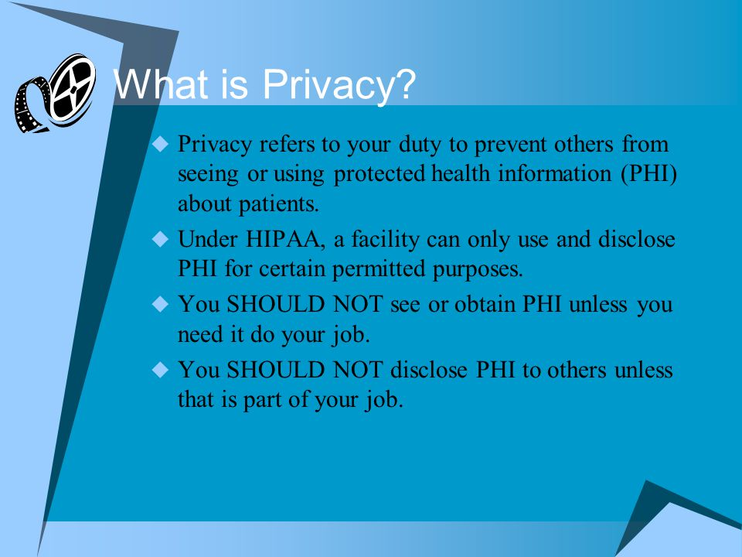

Slide 10

Infection Control
Hand hygiene is the single most important measure to protect patients, visitors, volunteers, and employees from getting infections. Everyone needs to wash their hands before and after patient contact, after glove removal, after blowing their nose, after using the restroom and after any unclean task. Always wash your hands before and after eating or drinking. Good hand washing can be accomplished using the following procedures:
When washing with water:
Wet hands under running water. Apply soap and distribute on hands.
Using friction, wash all surfaces of the hands for 20 seconds.
Rinse hands thoroughly under running water.
Dry hands with a paper towel. Turn off the faucet with a paper towel.
When washing with alcohol-based hand rub:
Apply product to palm of one hand and rub hands together, covering all surfaces of the hands.
Rub hands briskly until they feel comfortably dry (approx. 15 seconds).
Do not rinse. No water or towels are needed.

Slide 13

What if I’m not feeling well?
If you are experiencing any of the listed symptoms for COVID-19, or any flu-like symptoms, it is critically important that you call out for your shift.
Cough
Fever greater than 100.0 degrees
Chills
Muscle Pain
Shortness of breath/difficulty breathing
Sore throat
New loss of smell or taste
Nausea/vomiting
Please call Volunteer services at 757-398-2314 or email sherry_hill2@bshsi.org to let us know you won’t be in.

Slide 14
Wearing a Mask
MASKS!
Currently Masks are optional
If you wear a mask not provided by the hospital it should be laundered after each use

Slide 15
If you wear a mask here is the proper way:
Sanitize
Wash your hands before putting on your face covering
Place
Put the mask on over your nose and mouth and secure it under your chin
Fit
Lightly pinch the top of the mask around your nose and fit snugly against the sides of your face
Breathe
Make sure you can breathe easily
Do Not
Do not put the mask down around your neck or over your forehead - EVER

Slide 16
What else should I know?
You can wear your hospital acquired mask a few times before discarding, unless it becomes soiled or ripped.
Do NOT touch your face mask while it is on your face! If you touch your mask you must sanitize your hands immediately.
When not in use your mask should be stored in a paper bag. A plastic bag does not allow the mask to dry properly.
Do not share your mask with anyone else or leave it unattended unless stored in designated area.

Slide 19
Safety Information
Fire Safety
 | Fire. Staff in the affected area should follow R-A-C-E (see Discovering A Fire below). All other staff should close doors, stay off elevators, and limited movement in the building until the “all clear” is announced.
 | The first person discovering a fire or detecting the distinctive odor of smoke should: R Rescue (if someone is in need of rescue) A Alarm (and dial “66” to report location, etc.) C Contain (close doors/windows to contain the fire) E Extinguish/Evacuate
 | Be aware of fire extinguisher locations and know how to use them. P Pull (the pin at the top of the extinguisher) A Aim (the extinguisher nozzle at the base of the flame) S Squeeze (the trigger while holding the extinguisher upright) S Sweep (the extinguisher from side to side covering the fire area)
 | Volunteers will normally exit via the nearest safe exit and may be selectively involved with patient movement at the request of senior persons on the fire site when urgent situations occur. Depending on time and circumstances, maintenance personnel will quickly remove volatile/combustible materials to a safe site. Everyone should conduct themselves calmly and attempt to reassure visitors/patients.
Other
 |  | Dial “66” for fire, Security, or other emergencies (at Maryview).
 |  | Hazardous Materials Plan, Bomb Threat Policy, Incident Reporting System, Emergency Operations Plan, and Safety Committee Policies are in the Volunteer department.

Slide 20
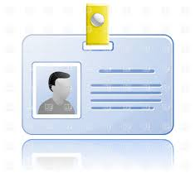
Name Badges
Identification badges will be issued to all persons accepted for Student Volunteer work by Bon Secours Maryview Medical Center.
These badges must be worn, picture forward, at all times when on duty and must be openly displayed on clothing above the waist to be easily read.
The badge must be returned at the end of the Student Volunteer Session of volunteering.

Slide 21

General Information
Be in uniform while on duty
Be in your assigned area and on task
No cell phone use while on duty
Arrive on time
Leave on time (unless special arrangements
have been made with the Director of Volunteers)
No gum chewing
Always be at your best!

Slide 22

You are almost finished!
If you are unclear about anything in the orientation, please contact the Volunteer Office before testing.
*Please proceed to the next page for test instructions.

Slide 23
Survey Instructions
Please click the attached document named “Student Orientation Quiz” on the Volunteer page
Save As- “Orientation Quiz” on your personal drive or print it
Complete Test
Send test back in an email to Sherry_hill2@bshsi.org , fax it to me or print it and drop it off to the Volunteer Office before your first day.

Slide 24

This concludes your orientation!

